Slide 1
Monoclonal antibodies
Dr Oyaro

Slide 2
Learning objectives
Definitions involved
Process of purification/isolation
Uses and applications

Slide 3
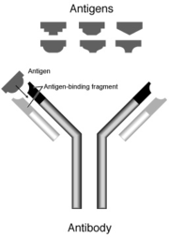

Slide 4
Definitions
Fab = Fragment, antigen binding
Fc = Fragment, crystalline
The Fc fragment specifies other biological activities of the molecule. For example, the Fc fragment may determine whether the antibody simply prevents signaling through a receptor, or alternatively, causes the cell’s destruction through complement fixation or targeting immune effector cells.

Slide 5
Monoclonal antibodies (mAb or moAb)
Monoclonal antibodies are:
monospecific antibodies that are identical because they are produced by one type of immune cell (a single parent cell).
Antibodies produced from a single clone of B cells.
Produced by fusing a B cell secreting the desired antibody with a myeloma cell capable of growing indefinitely in tissue culture.
Monoclonal antibodies all have identical antigen-binding sites. i.e. they all bind to the same epitope with the same affinity.
They are all of the same antibody class (isotype).

Slide 6
Polyclonal antibodies
are a mixture of antibodies with different antigen binding sites that may bind to different epitopes or antigens with varying affinities.
They may be of different antibody classes.
The serum obtained from an immunized animal is referred to as a polyclonal antiserum.

Slide 7
Hybridoma
are cells that have been engineered to produce a desired antibody in large amounts.
To produce monoclonal antibodies, B-cells are removed from the spleen of an animal that has been challenged with the relevant antigen
These B-cells are then fused with myeloma tumor cells that can grow indefinitely in culture
This fusion is performed by making the cell membranes more permeable.
The fused hybrid cells (hybridomas), being cancer cells, will multiply rapidly and indefinitely and will produce large amounts of the desired antibodies

Slide 8
Practical steps in monoclonal antibody production:
1) Immunize animal
2) Isolate spleen cells (containing antibody-producing B cells)
3) Fuse spleen cells with myeloma cells (e.g. using PEG - polyethylene glycol)
4) Allow unfused B cells to die
5) Add aminopterin to culture to kill unfused myeloma cells
6) Clone remaining cells (place 1 cell/well and allow each cell to grow into a clone of cells)
7) Screen supernatant of each clone for presence of the desired antibody.
8) Grow the chosen clone of cells in tissue culture indefinitely.
9) Harvest antibody from the culture supernatant.

Slide 9
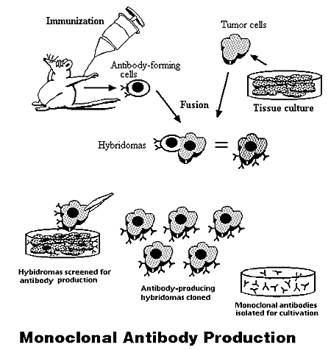

Slide 10
Hybridoma Selection
The “HAT Trick”
Myeloma cells lack certain enzymes so that they can not use hypoxanthine, aminopterin, and thymidine(HAT medium) as a source for nucleic acid biosynthesis and will die in culture.
Only B cells that have fused with the engineered myeloma cells will survive in culture when grown in HAT medium.

Slide 11
Purification of monoclonal Antibodies
Cotaminants:
Media components: hormones, growth factors, transferrins……etc
Viral, bacterial,endotoxins….etc
Methods of purification:
Filteration for larger particles
Ultrafilteration esp. for low concentration samples
Chromatography:
Ion exchange chromatography (either cation or anion) can be used (Most impurities are usually anions)
Size exclusion chromatography

Slide 12
Recombinant monoclonal antibodies
The term recombinant and especially recombinant DNA refers to an artificial method of producing DNA (synthetic DNA and proteins).
Recombinant DNA is produced through the addition of relevant DNA into an existing organismal genome, such as the plasmid of bacteria
Recombinant antibody engineering involves the use of viruses or yeast to create antibodies, rather than mice.
A segment of DNA is recombined (recombinant) with the original DNA of the bacteria, these genetically modified bacteria rapidly reproduce and by that reproduce the DNA segment that was recombined with the original genome.

Slide 13
Uses of monoclonal Abs
Measuring protein and drug levels in serum
Typing tissue and blood
Identifying infectious agents
Identifying clusters of differentiation (CDs) for
classification and follow-up therapy of leukemias and
lymphomas
Identifying tumor metastasis
Identifying and quantifying hormones
Immunoaffinity Purification

Slide 14
Applications of Monoclonal Antibodies
Diagnostic Applications
Therapeutic Applications
Transplant rejection
Cardiovascular disease
Cancer
Infectious Diseases
Inflammatory disease
Clinical Applications
Purification of drugs, Imaging the target
Future Applications
Fight against Bioterrorism

Slide 15
Diagnostic Applications (Immuno-ctochemistry)
Tissues and tumors can be classified based on their expression of certain defined markers: e.g. Prostate specific antigen(PSA)
Classification of tissues and tumors
Distinguishing morphologically similar lesions, like mesothelioma and adenocarcinoma
Detecting small quantities of metastatic cancer and MDR

Slide 16
Therapeutic Applications
One possible treatment for cancer involves monoclonal antibodies that bind only to cancer cell-specific antigens and induce an immunological response against cancer cells.
Three mechanisms responsible for the cancer treatment:
mAbs act directely when binding to a cancer specific antigens and induce immunological response to cancer cells(apoptosis, inhibiting growth)
mAbs can be modified for delivery of a toxin, radioisotope, cytokine or other active conjugates.
it is also possible to design bispecific antibodies that can bind with their Fab regions both to target antigen and to an effector cell

Slide 17
‘Naked’ Monoclonal Antibodies
‘Naked’ means these antibodies are not fused to a toxin.
Naked Monoclonal antibodies can kill cells via a variety of mechanisms, including: Antibody-Dependent Cellular Cytotoxicity (ADCC), Complement-Dependent Cytotoxicity (CDC), and direct induction of apoptosis.
However, the precise clinical mechanisms often remain uncertain

Slide 18
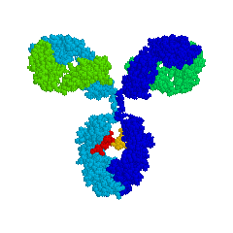
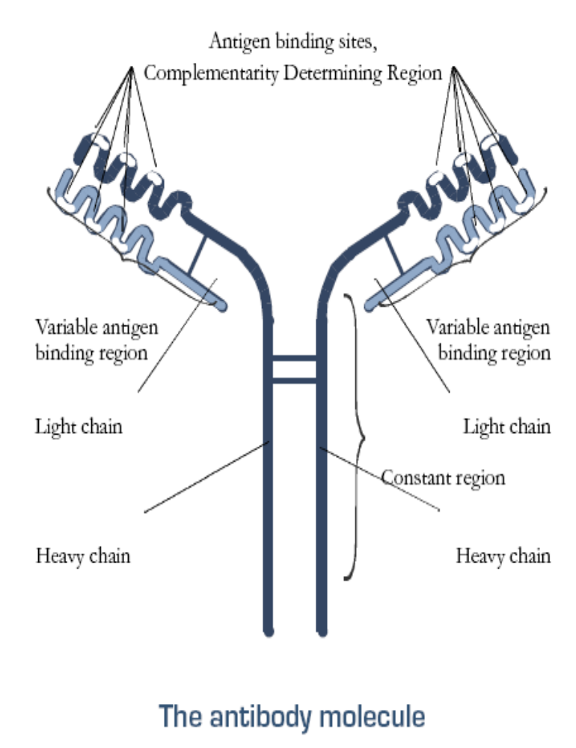
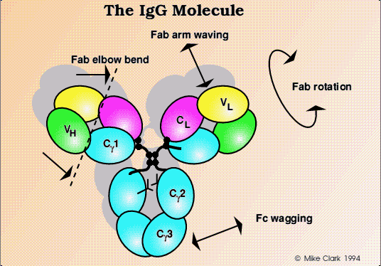
The structure of antibodies
http://www.path.cam.ac.uk/~mrc7/igs/mikeimages.html

Slide 19
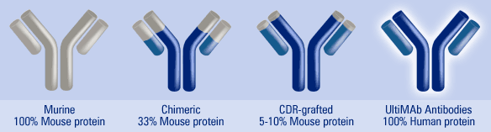
Evolution of Therapeutic Antibodies

Slide 20
Nomenclature of Therapeutic Antibodies
Terminate the name in –ximab for chimeric antibodies and –umab for humanized antibodies.

Slide 21
Rituximab (Rituxan)
Rituximab is a chimeric monoclonal antibody that targets the CD20 B-cell antigen.
This antigen is expressed on 90% of B-cell neoplasms
The precise biological functions of CD20 are uncertain, but the antibody is believed to function by flagging the B-cells for destruction by the body’s own immune system, including ADCC, CDC, and apoptosis.
This antibody thus leads to the elimination of all B-cells from the body (including cancerous ones), allowing new, healthy B-cells to be produced from lymphoid stem cells.

Slide 22
More reading on the recommended!
Thank

